Slide 1

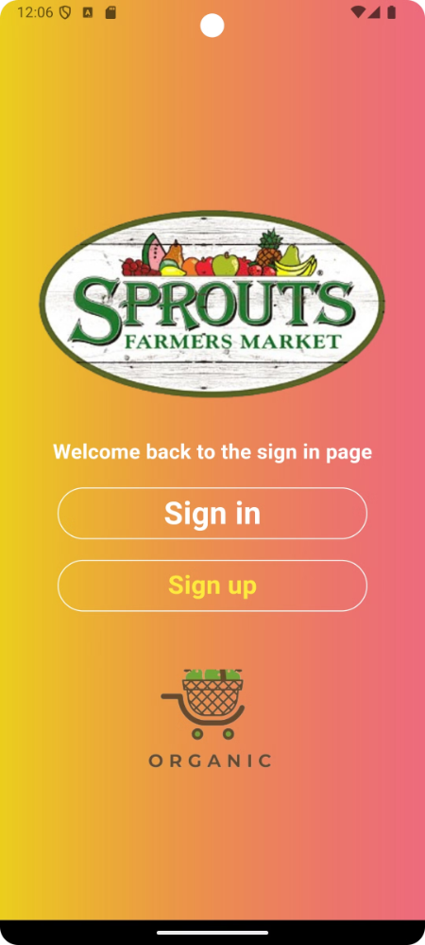

Welcome to Our App
This application is your gateway to a world of possibilities. Discover exciting features, explore curated content, and engage with a vibrant community.
by shankar medagam
sm

Slide 2
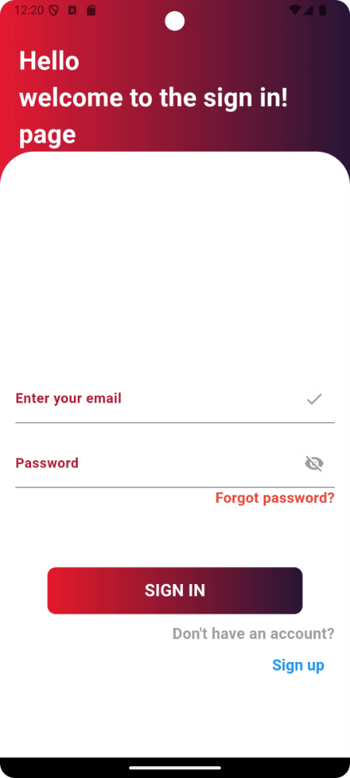
Login Screen
Existing Users
Return to the world of our app by entering your email and password.
Password Recovery
Forgot your password? No problem. Reset it easily by entering your email address.

Slide 3
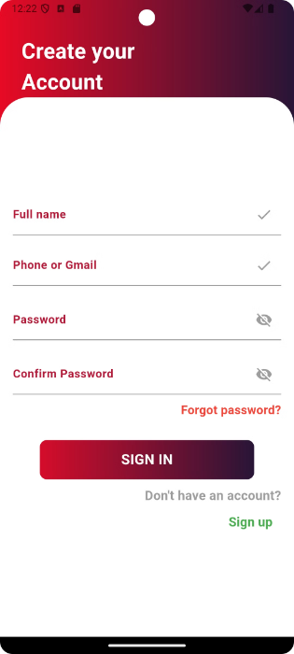
Registration Screen
Personal Information
Privacy and Security
Create your unique account by providing basic details, including name, email, and password.
Your information is kept safe and secure, ensuring a trustworthy experience.

Slide 5
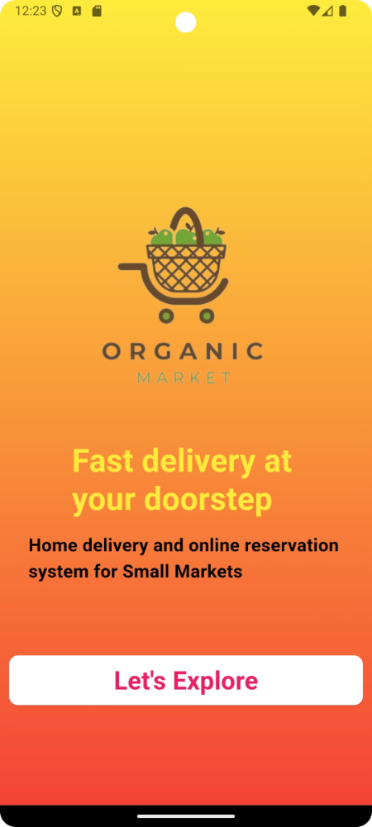



First Screen
Welcome Message
A friendly welcome message greets you upon your first login.
Tutorial
Learn about the app's key features and navigate with ease.
Start Exploring
Dive into the app's world of possibilities and begin your journey.

Slide 6
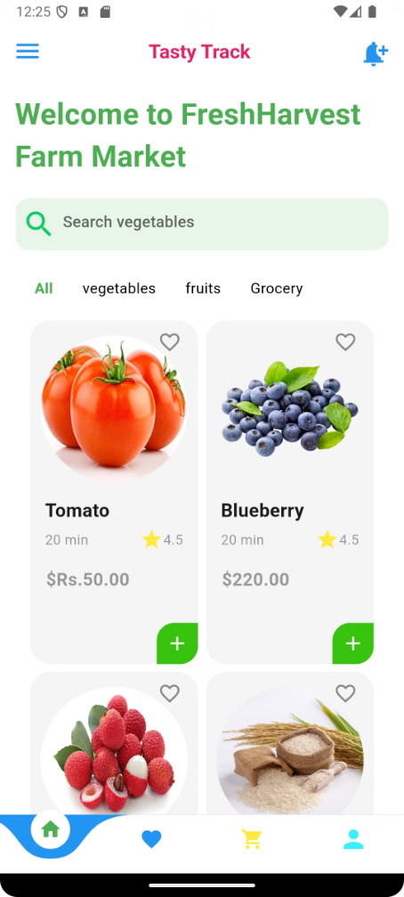
Home Page
1
Featured Content
Discover curated content tailored to your interests.
2
Personalized Recommendations
Receive suggestions based on your preferences and past interactions.
3
Navigation Menu
Easily access different sections of the app, from product browsing to user profiles.
4
Search Bar
Quickly find what you're looking for with a convenient search function.

Slide 7
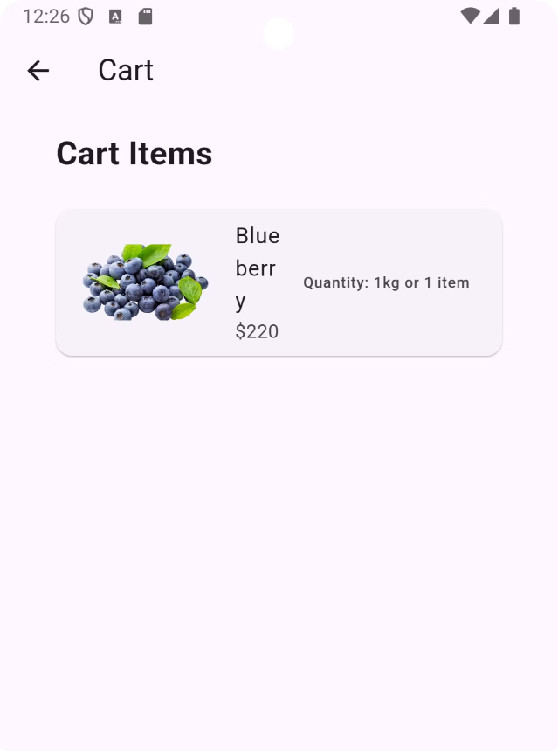
Cart Page
Item
Quantity
Price
Product 1
2
$29.99
Product 2
1
$14.99

Slide 8
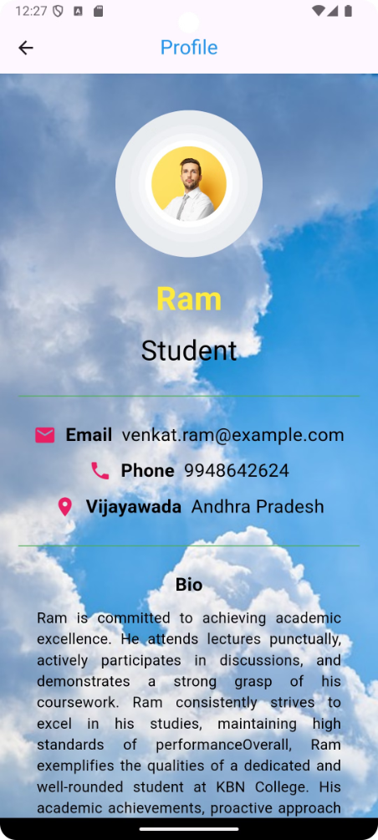




Profile Page
Account Settings
Order History
Manage your personal information, including email address, password, and notification preferences.
Review past purchases and track orders.
Wishlist
Notifications
Save items you like for later purchase.
Stay updated on the latest deals, promotions, and important updates.

Slide 9

Conclusion
This app is designed to enhance your experience, offer convenience, and provide valuable features to meet your needs. We hope you enjoy the journey.

